Slide 1

EVENT TICKETING SYSTEM
FATIMA KHALID –BSSE23104
FATIMA NOORULAIN-BSSE23003

Slide 2
Project Proposal, Executive Summary & Problem Definition
Executive Summary:-
The Event Ticketing System is a cloud-based web application designed to provide a secure, scalable, and efficient platform for online event ticket booking. Traditional ticketing systems often fail during high traffic, lack real-time updates, and suffer from security and scalability issues. This project uses Amazon Web Services (AWS) to build a serverless solution where the frontend is hosted on Amazon S3, backend logic is handled by AWS Lambda, and APIs are managed through Amazon API Gateway. The system ensures high availability, real-time ticket management, and cost-efficient deployment suitable for real-world event scenarios

Slide 3
Introduction
With the increasing number of online events, there is a growing need for reliable and scalable ticketing systems. Many existing platforms rely on traditional server-based architectures that cannot efficiently handle traffic spikes. Cloud computing offers on-demand scalability, security, and reliability. This project implements an Event Ticketing System using AWS serverless services to provide a modern, efficient, and highly available solution for event management.
Problem Statement
Existing event ticketing systems often experience slow performance, downtime during peak usage, and security vulnerabilities. These issues lead to poor user experience and revenue loss for event organizers. There is a need for a cloud-based ticketing system that can handle high traffic, provide real-time ticket availability, and ensure secure access. This project addresses these challenges using AWS cloud infrastructure.

Slide 4
Aim & Objectives
Aim:
To design and implement a scalable and secure Event Ticketing System using AWS cloud services.
Objectives:
Develop a static frontend hosted on Amazon S3
Implement backend processing using AWS Lambda
Manage API communication with Amazon API Gateway
Ensure scalability, availability, and security
Demonstrate practical use of AWS serverless architecture

Slide 5
2. AWS ARCHITECTURE DESIGN, IMPLEMENTATION STEPS &amp; SCREENSHOTS

Slide 6
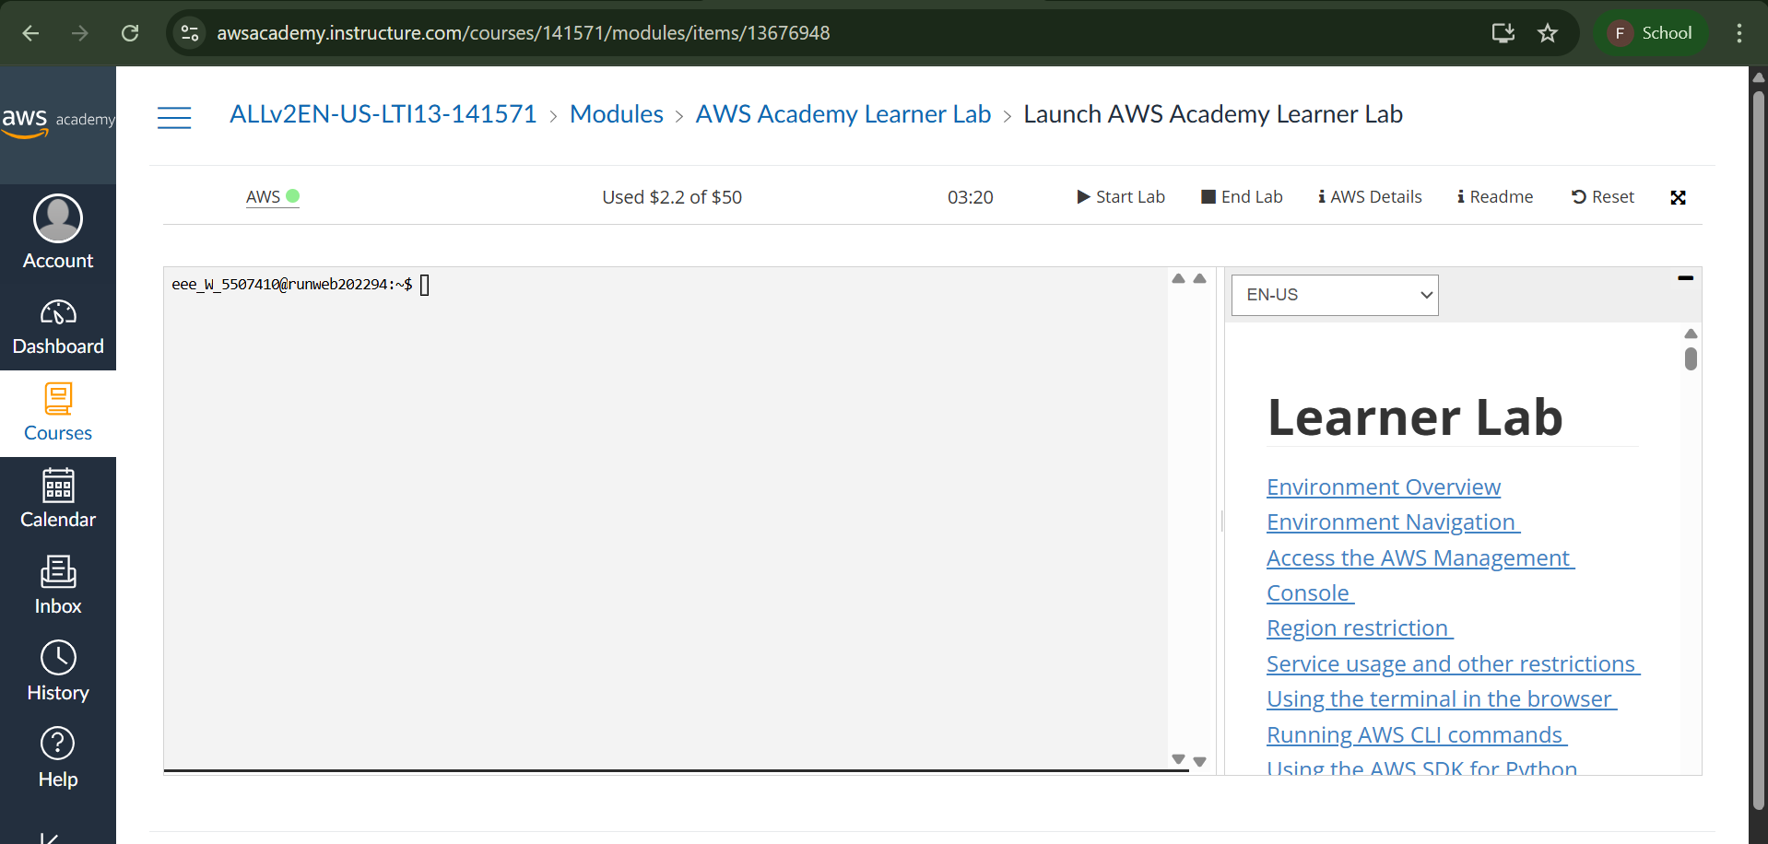

Slide 7
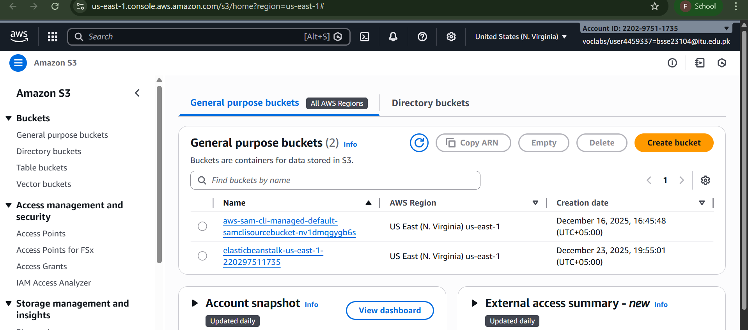

Slide 8
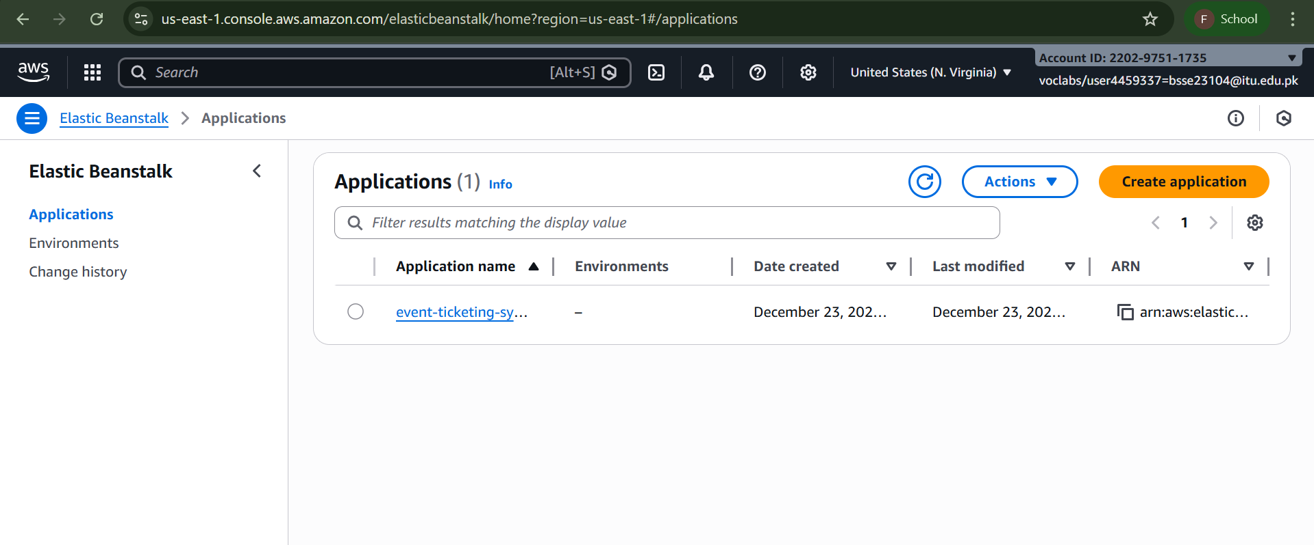

Slide 9
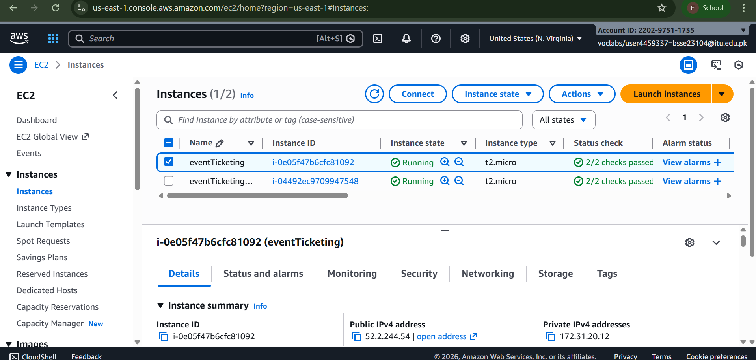

Slide 10
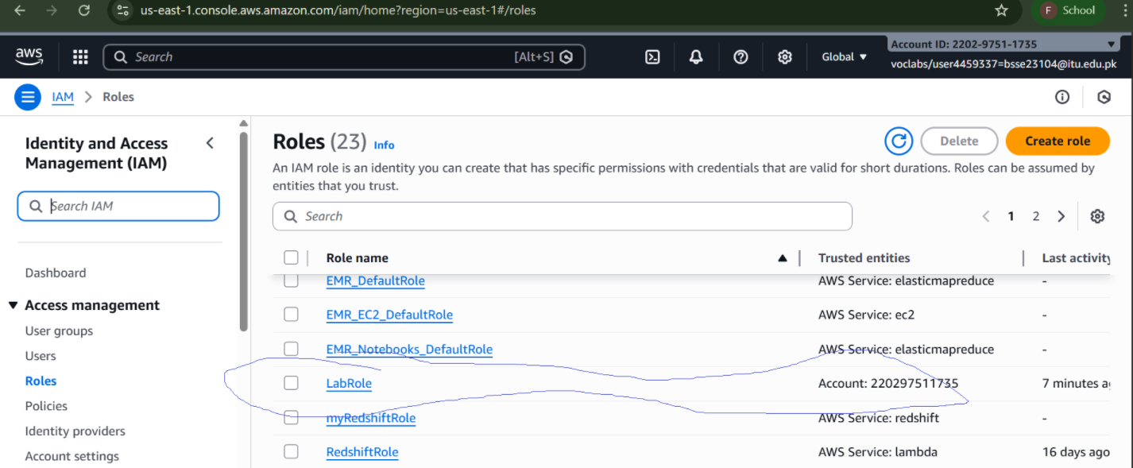

Slide 11
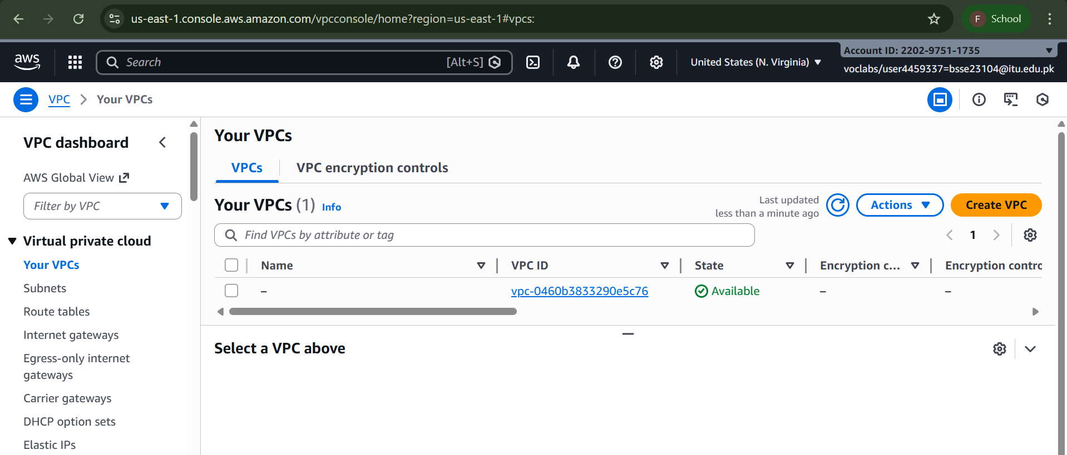

Slide 12
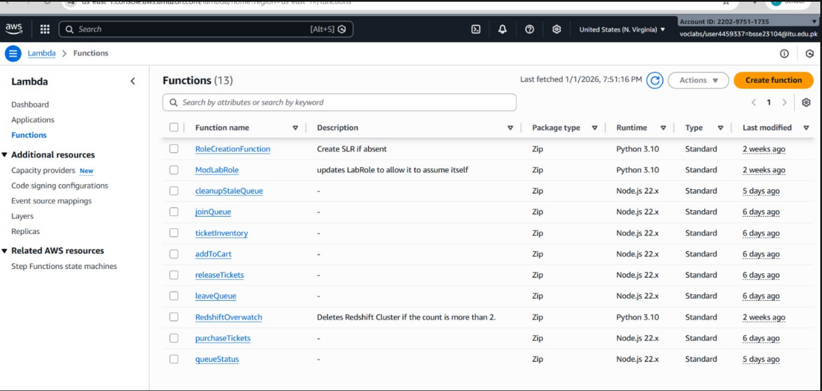

Slide 13
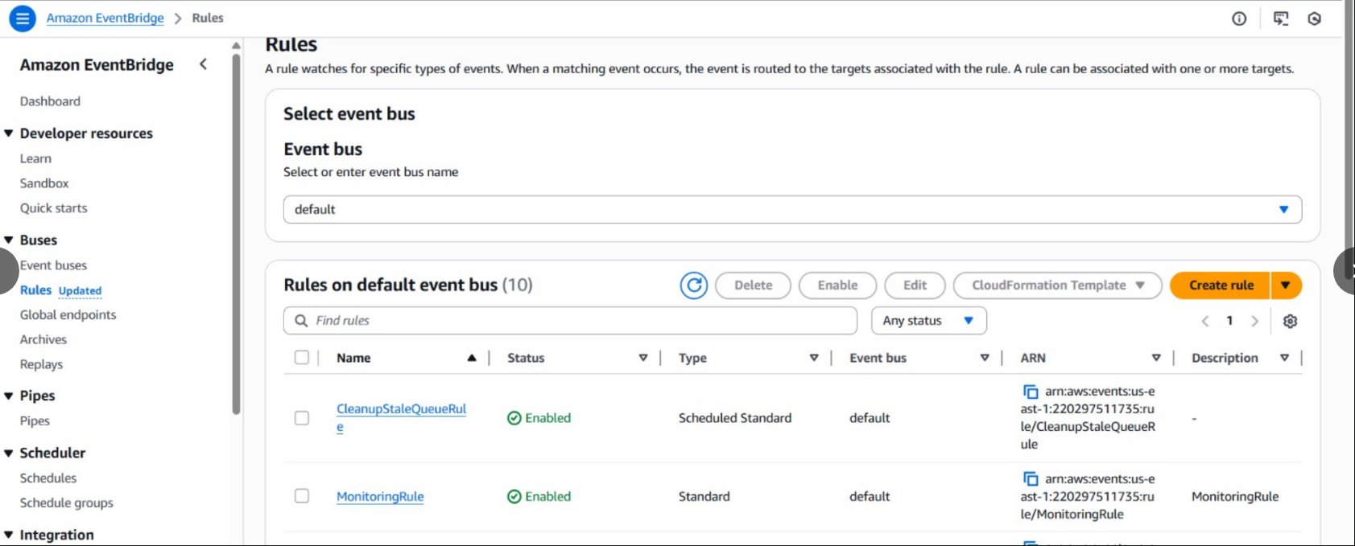

Slide 14
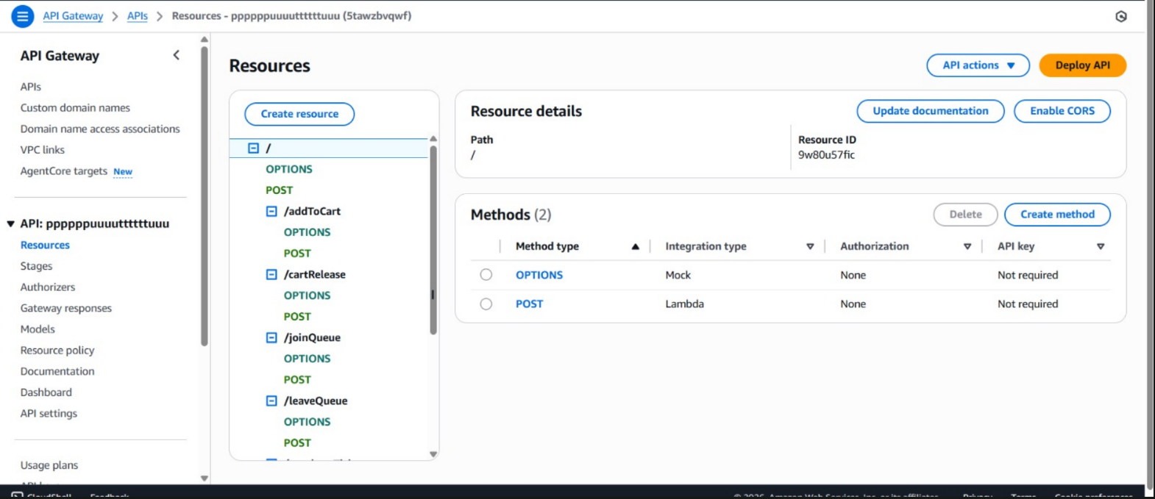

Slide 15
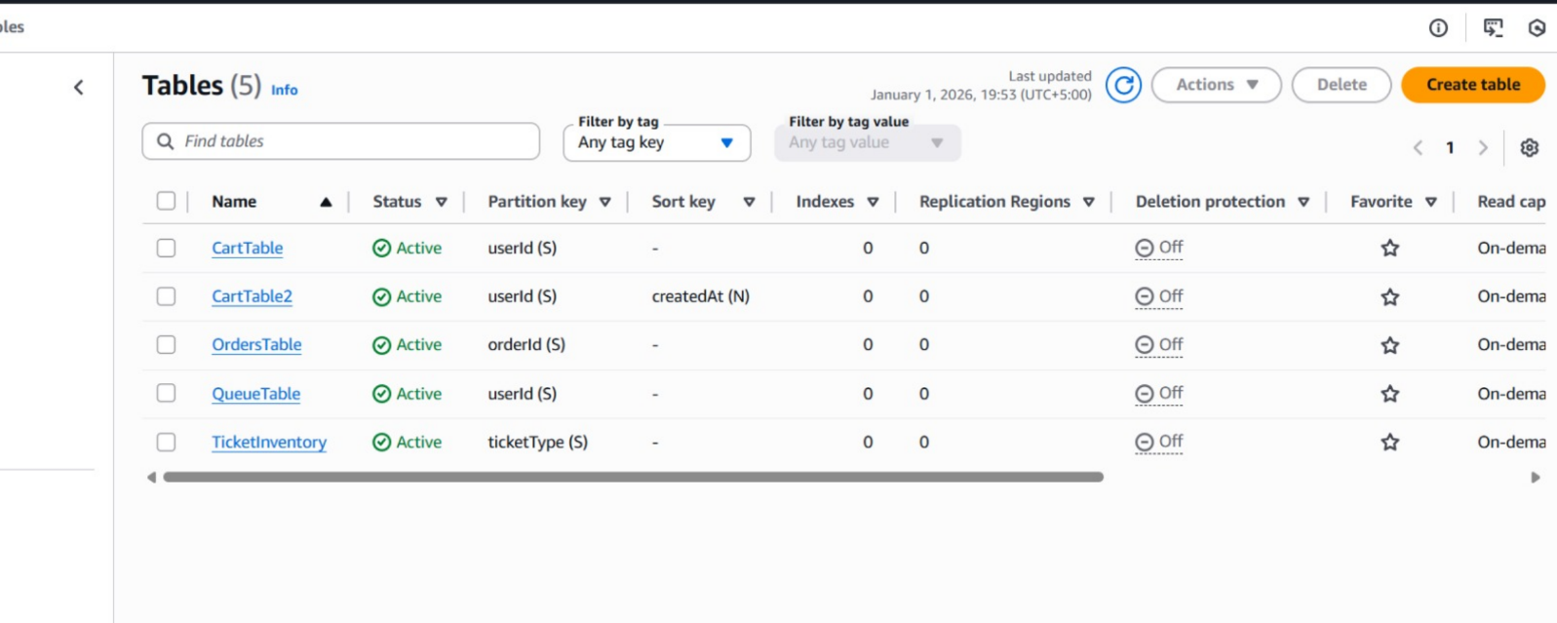

Slide 16
References
Amazon Web Services. (2024). Amazon S3 User Guide.
https://docs.aws.amazon.com/s3/
Amazon Web Services. (2024). AWS Lambda Developer Guide.
https://docs.aws.amazon.com/lambda/
Amazon Web Services. (2024). Amazon API Gateway Developer Guide.
https://docs.aws.amazon.com/apigateway/
Fielding, R. T. (2000). Architectural styles and the design of network-based software architectures. Doctoral dissertation, University of California.
Mozilla Developer Network. (2024). JavaScript Documentation.
https://developer.mozilla.org/

Slide 17
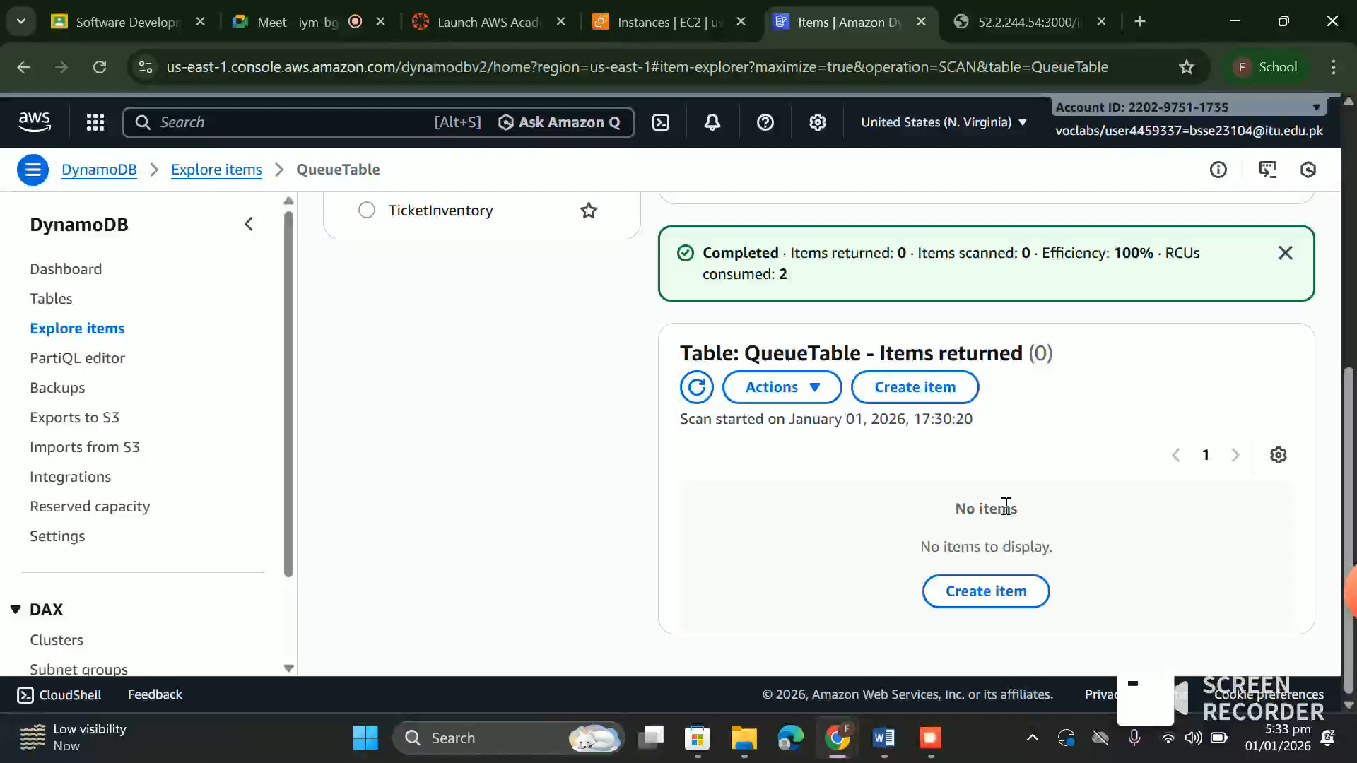

Slide 18
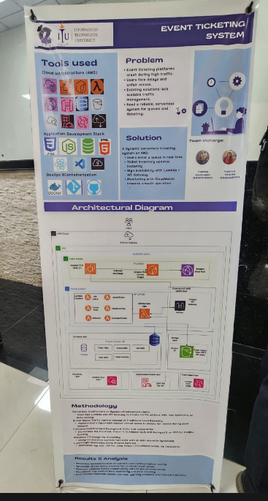

Slide 19
THANK YOU!
BYY

